Slide 1
Addition Quiz
By Olivia Bravo and Tynesha Dorsey

Slide 2
Introduction
This program is written in C++ for children to add two random numbers
In total there are 10 questions
For each correct answer, the score will increase
After all questions are answered, the final score will be displayed

Slide 3
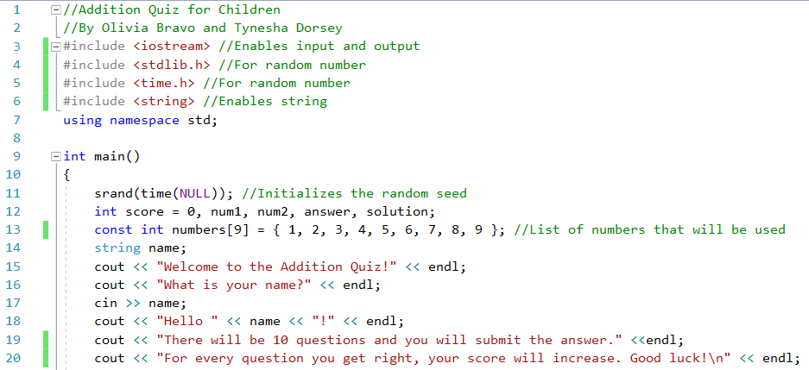

Slide 4
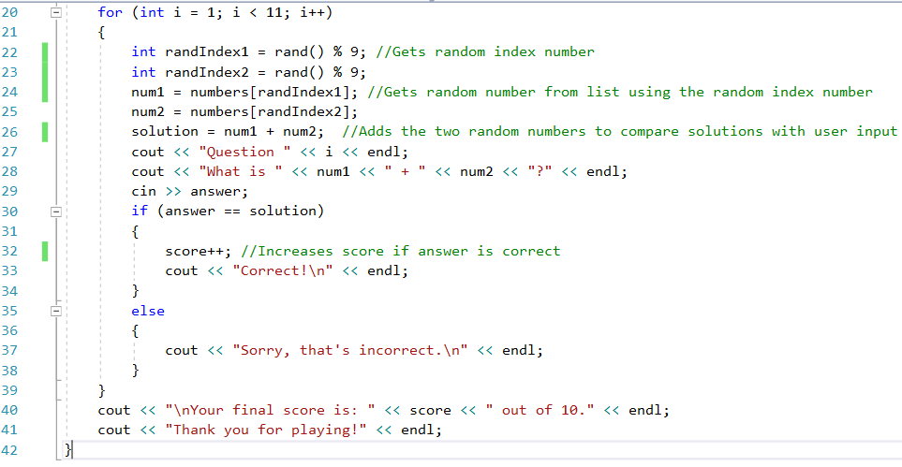

Slide 5
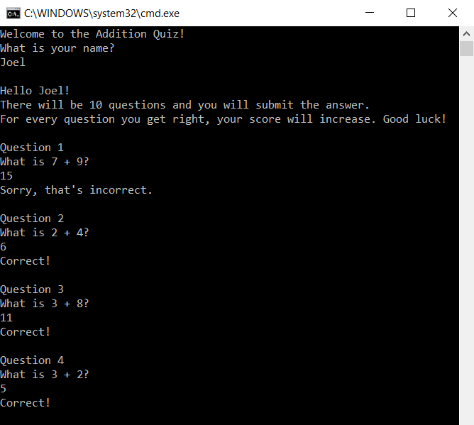
OUTPUT

Slide 6
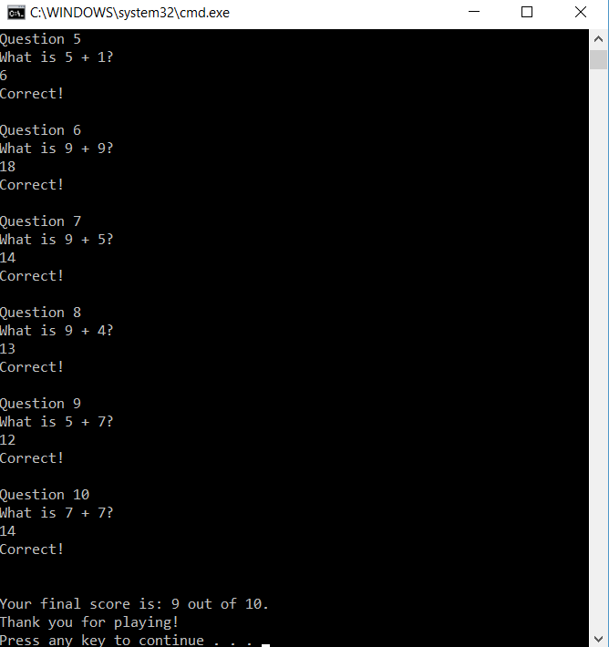
OUTPUT

